Slide 1
SMART INTERNET PROBING: SCANNING USING ADAPTIVE MACHINE LEARNING

Slide 2
Abstract
Network scanning is widely used to assess security postures of hosts/networks, discover vulnerabilities, and study Internet trends. However, scans can generate large amounts of traffic, and efficient probing of IPv6 hosts (where global scans are infeasible) is an outstanding problem. In this chapter, we develop a framework for efficient Internet scans using machine learning, by preemptively detecting and avoiding the scanning of inactive hosts. We evaluate this framework over global scans of the IPv4 space over 20 ports, and show that using location and ownership information we can reduce the bandwidth of scans by 26.7-72.0%, while discovering 90-99% of active hosts.

Slide 3
INTRODUCTION
Network scanning is a widely studied topic, ranging from partial scans of the Internet, to global scans of the IPv4 address space. This has lead to the development of network scanning tools such as ZMap and NMap which have provided researchers with large amounts of information on arbitrary Internet hosts. Data resulting from network scans have been used in a wide range of security studies, e.g., to probe and characterize machines utilized in the Mirai botnet, to gauge the security posture of networks for cyber-risk forecasting and to study hosts susceptible to the Heartbleed vulnerability.

Slide 4
LITERATURE SURVEY
Selecting representative IP addresses for Internet topology studies
Authors: X. Fan and J. Heidemann
Abstract: An Internet hitlist is a set of addresses that cover and can represent the the Internet as a whole. Hitlists have long been used in studies of Internet topology, reachability, and performance, serving as the destinations of traceroute or performance probes. Most early topology studies used manually generated lists of prominent addresses, but evolution and growth of the Internet make human maintenance untenable.

Slide 5
LITERATURE SURVEY
Target generation for Internet-wide IPv6 scanning
Authors: A. Murdock, F. Li, P. Bramsen, Z. Durumeric, and V. Paxson
Abstract: Fast IPv4 scanning has enabled researchers to answer a wealth of new security and measurement questions. However, while increased network speeds and computational power have enabled comprehensive scans of the IPv4 address space, a brute-force approach does not scale to IPv6. Systems are limited to scanning a small fraction of the IPv6 address space and require an algorithmic approach to determine a small set of candidate addresses to probe.

Slide 6
LITERATURE SURVEY
ZMap: Fast Internetwide scanning and its security applications
Authors: Z. Durumeric, E. Wustrow, and J. A. Halderman
Abstract: Internet-wide network scanning has numerous security applications, including exposing new vulnerabilities and tracking the adoption of defensive mechanisms, but probing the entire public address space with existing tools is both difficult and slow. We introduce ZMap, a modular, open-source network scanner specifically architected to perform Internet-wide scans and capable of surveying the entire IPv4 address space in under 45 minutes from user space on a single machine, approaching the theoretical maximum speed of gigabit Ethernet

Slide 7
LITERATURE SURVEY
A search engine backed by Internet-wide scanning
Authors: Z. Durumeric, D. Adrian, A. Mirian, M. Bailey, and J. A. Halderman
Abstract: Fast Internet-wide scanning has opened new avenues for security research, ranging from uncovering widespread vulnerabilities in random number generators to tracking the evolving impact of Heartbleed. However, this technique still requires significant effort: even simple questions, such as, "What models of embedded devices prefer CBC ciphers?", require developing an application scanner, manually identifying and tagging devices, negotiating with network administrators, and responding to abuse complaints

Slide 8
EXISTING SYSTEM
Network scanning is widely used to assess security postures of hosts/networks, discover vulnerabilities, and study Internet trends. However, scans can generate large amounts of traffic, and efficient probing of IPv6 hosts (where global scans are infeasible) is an outstanding problem.
DISADVANTAGES OF EXISTING SYSTEM:
1. efficient probing of IPv6 hosts is an outstanding problem

Slide 9
PROPOSED SYSTEM
In this chapter, we develop a framework for efficient Internet scans using machine learning, by preemptively detecting and avoiding the scanning of inactive hosts. We evaluate this framework over global scans of the IPv4 space over 20 ports, and show that using location and ownership information we can reduce the bandwidth of scans while discovering of active hosts. We then evaluate a sequential method by gradually adding information obtained from scanned ports to adaptively predict the remaining port responses, yielding 47.4-83.5% of bandwidth savings at the same true positive rates.
Advantages of proposed system:
Our framework can be used to lower the bandwidth consumption of scans and increase their hit rate, thereby reducing their intrusive nature and enabling efficient discovery of active devices.

Slide 10
REQUIRMENTS
SOFTWARE REQUIREMENTS
The functional requirements or the overall description documents include the product perspective and features, operating system and operating environment, graphics requirements, design constraints and user documentation.
The appropriation of requirements and implementation constraints gives the general overview of the project in regards to what the areas of strength and deficit are and how to tackle them.
Python idel 3.7 version (or)
Anaconda 3.7 ( or)
Jupiter (or)
Google colab

Slide 11
REQUIRMENTS
HARDWARE REQUIREMENTS
Minimum hardware requirements are very dependent on the particular software being developed by a given Enthought Python / Canopy / VS Code user. Applications that need to store large arrays/objects in memory will require more RAM, whereas applications that need to perform numerous calculations or tasks more quickly will require a faster processor.
Operating system : windows, linux
Processor : minimum intel i3
Ram : minimum 4 gb
Hard disk : minimum 250gb

Slide 12
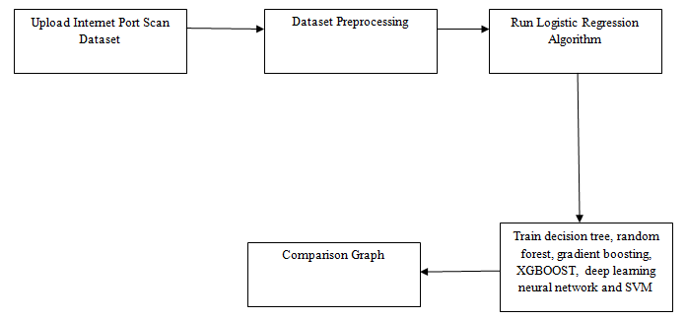
SYSTEM ARCHITECTURE

Slide 13
UML DIAGRAMS

Slide 14
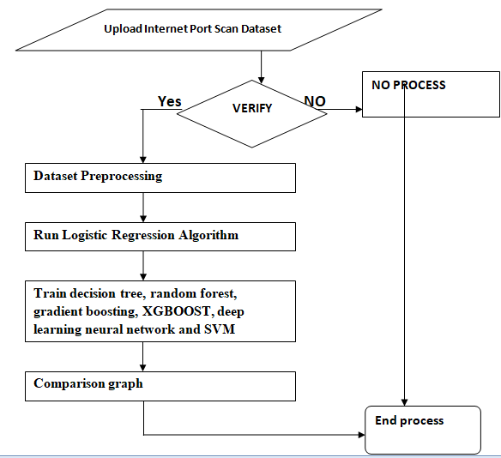
DATAFLOW DIAGRAM

Slide 15
USECASE DIAGRAM

Slide 16
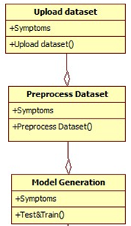
CLASS DIAGRAM

Slide 17
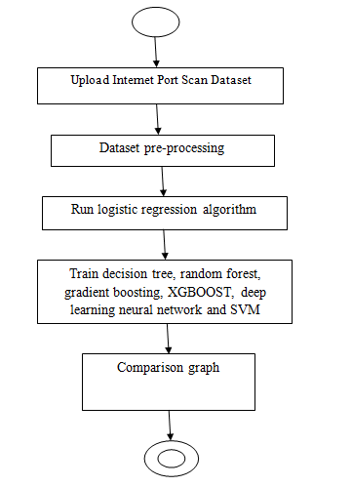
ACTIVITYDIAGRAM

Slide 18
SEQUENCE DIAGRAM

Slide 19
COLLABORATION DIAGRAM

Slide 20
COMPONENT DIAGRAM

Slide 21
DATAFLOW DIAGRAM

Slide 22
RESULTS

Slide 23
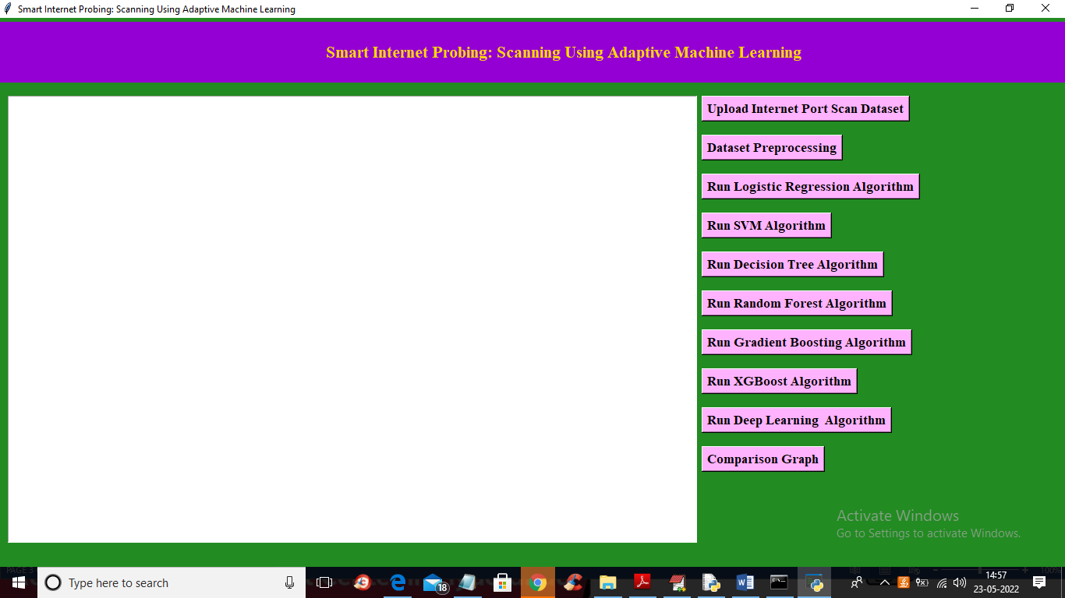

Slide 24
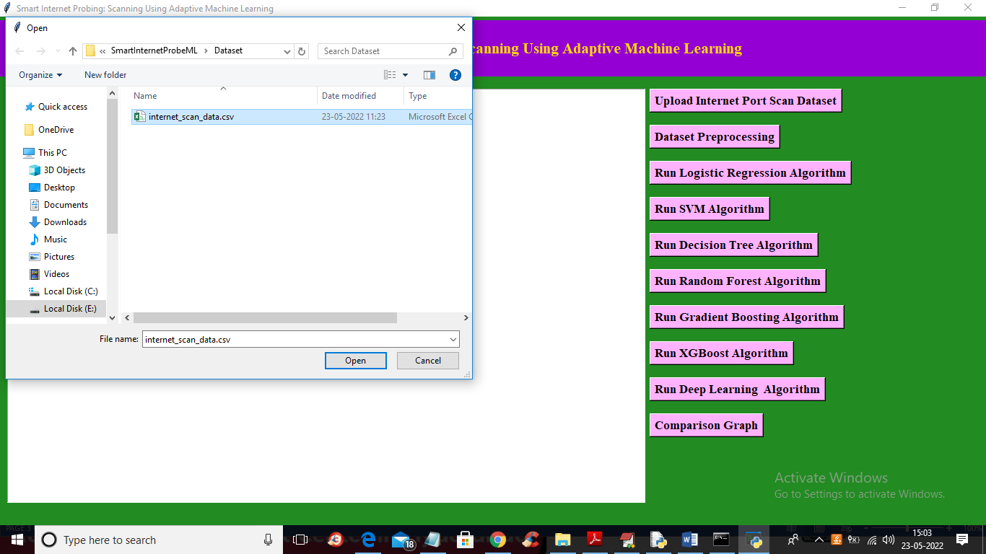

Slide 25
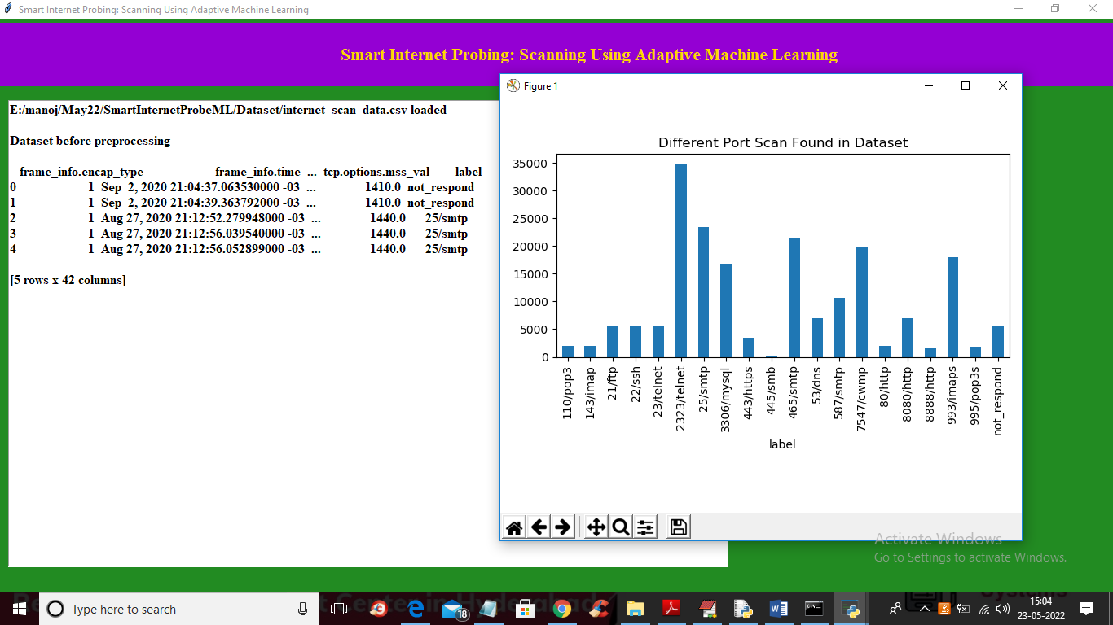

Slide 26
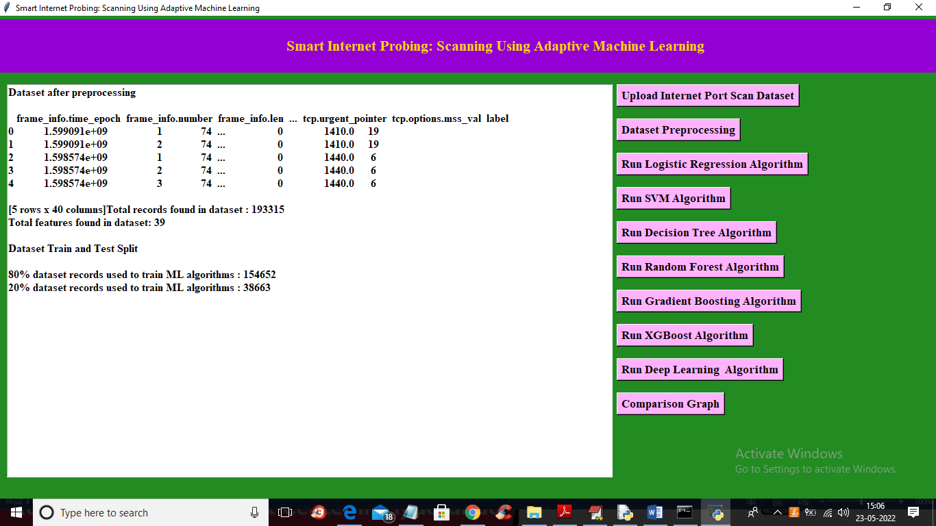

Slide 27
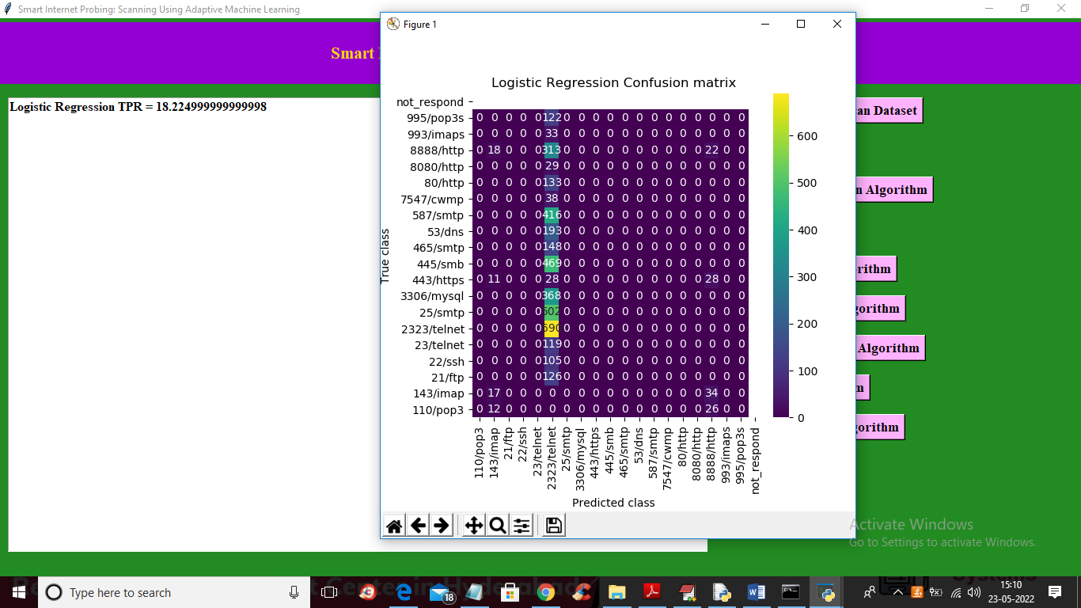

Slide 28
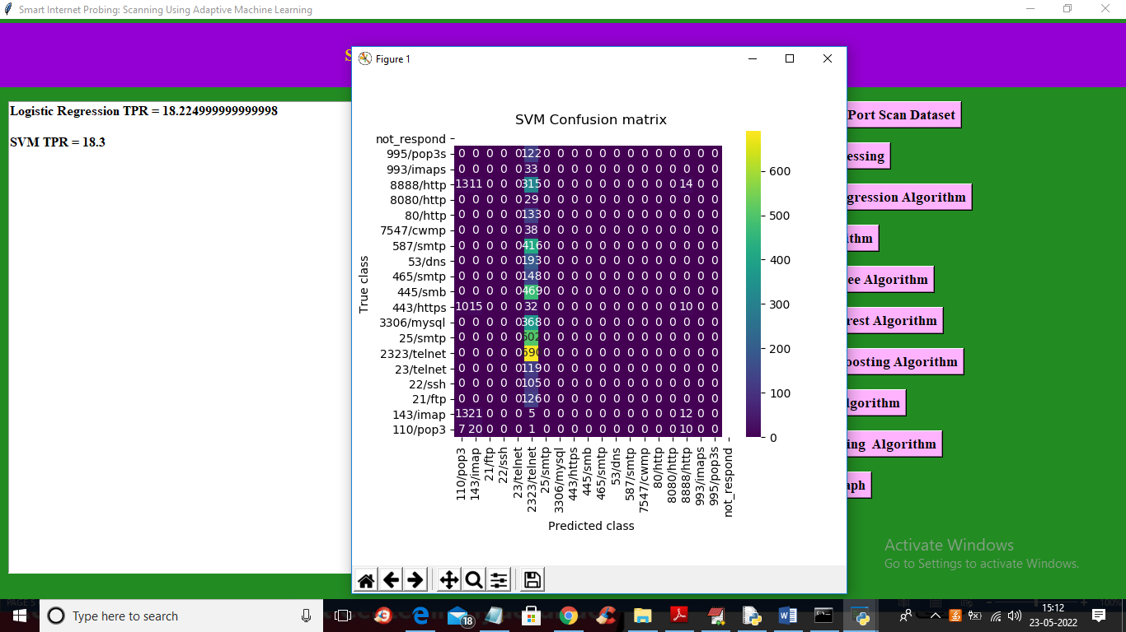

Slide 29
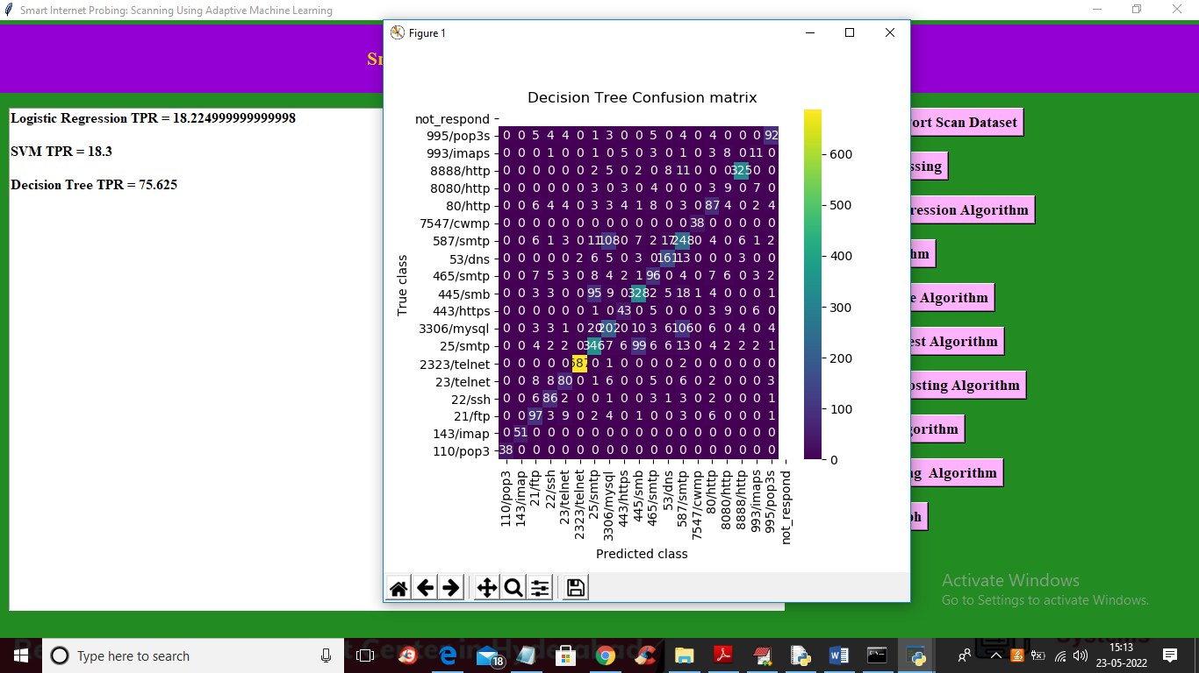

Slide 30
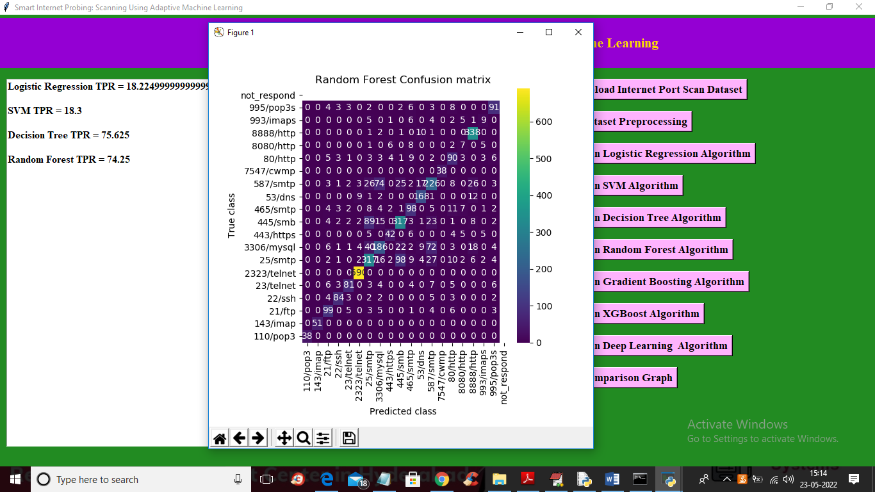

Slide 31
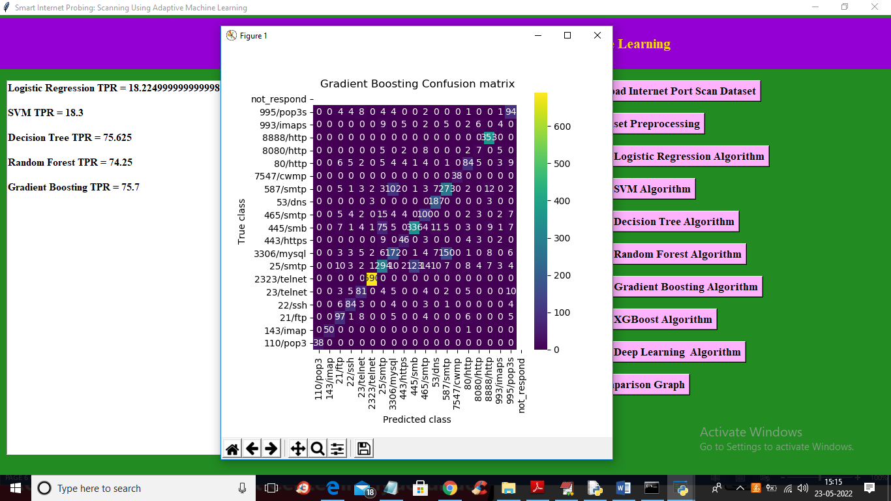

Slide 32
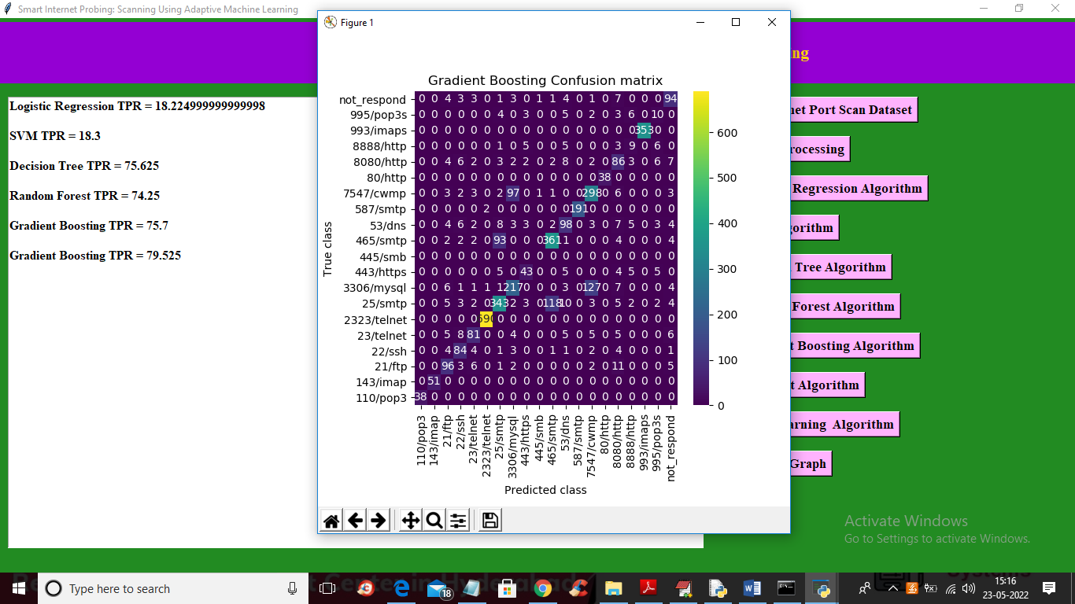

Slide 33
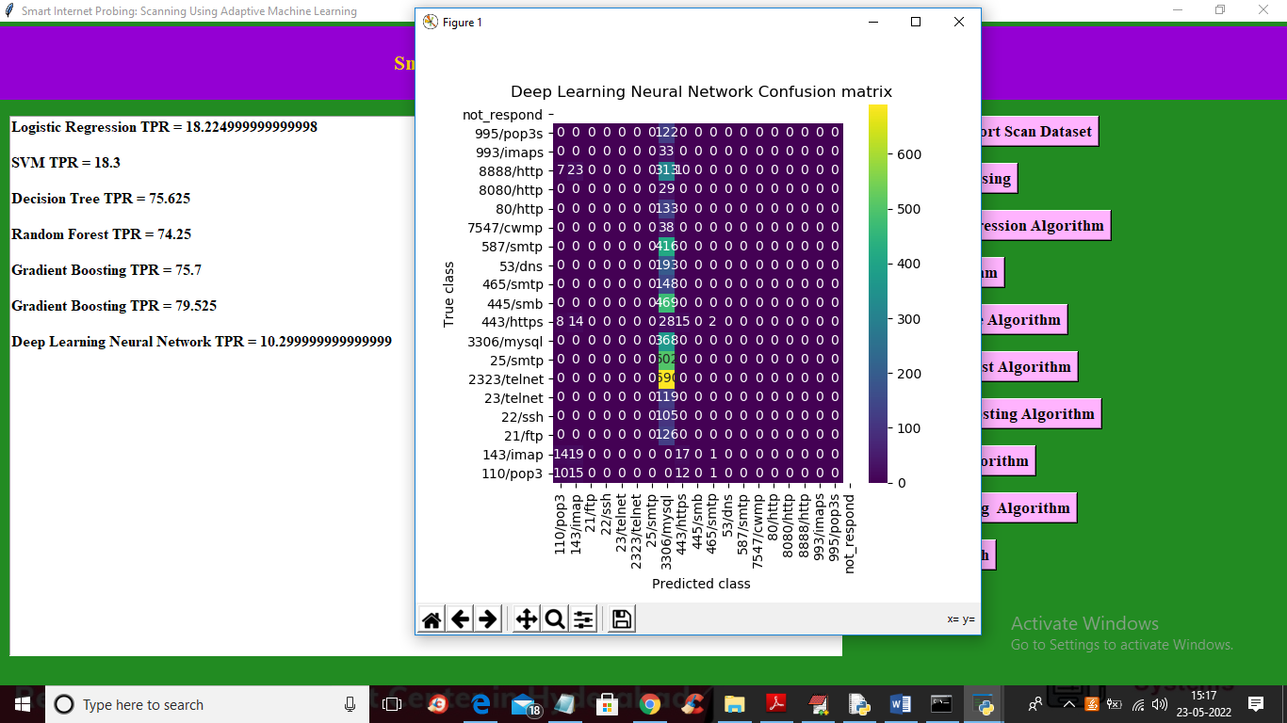

Slide 34
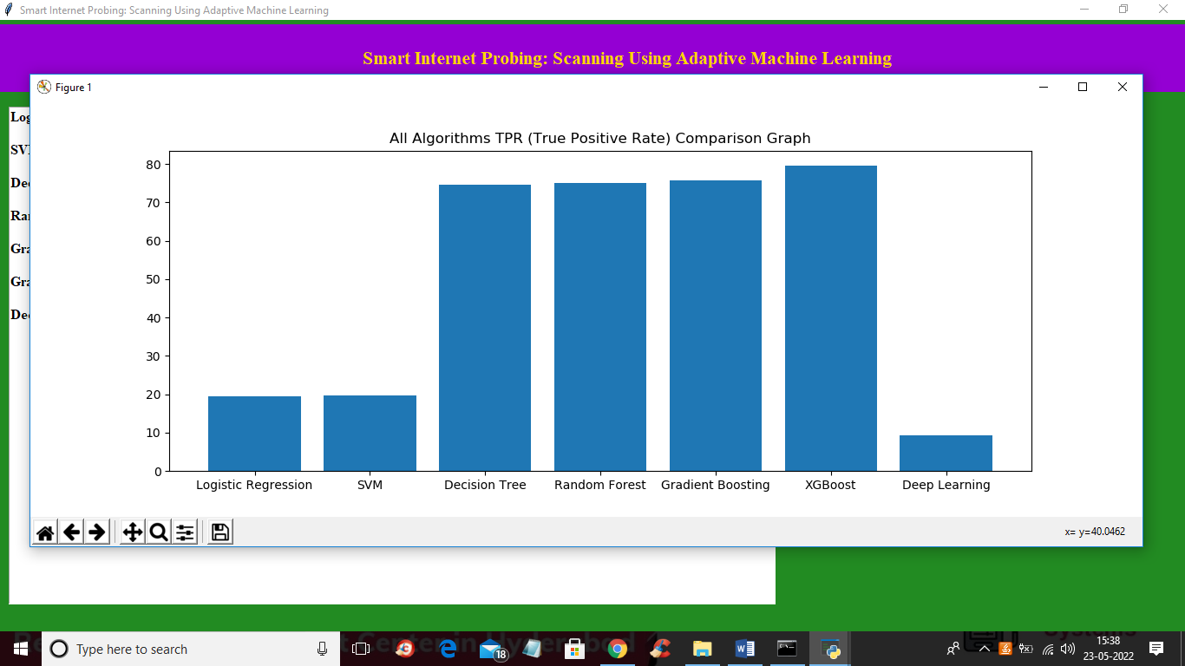

Slide 35
CONCLUSION
We compared our methodology to other strategies for conducting machine learning enabled scans, concluding that ignoring location and AS properties results in poor performance, while using the full set of features from stateful scans only provides marginal benefits, while significantly increasing computational requirements. We also showed that scans have consistent coverage along vulnerable and misconfigured subpopulations, and are therefore appropriate for efficient and accurate assessment of the attack surface of networks.

Slide 36
FUTURE SCOPE
We intend to apply our developed techniques to develop smart scanners that can efficiently scan IPv4 networks and IPv6 hitlists, increasing the hit rate for discovering active IPs. This allows scanners to scan IPv4 faster and less intrusively compared to exhaustive scans, while covering larger histlists for discovering more devices on IPv6. Additionally, using other sources of information, e.g., historical data, and local patterns in how devices are placed on the Internet (for example some networks might tend to put active devices at the start of their allocated IP blocks, while others might use random placement) can also help improve the efficiency of scans.

Slide 37
REFERENCES
[1] X. Fan and J. Heidemann, \Selecting representative IP addresses for Internet topology studies," in ACM SIGCOMM Conference on Internet Measurement. ACM, 2010, pp. 411{423.
[2] A. Murdock, F. Li, P. Bramsen, Z. Durumeric, and V. Paxson, \Target generation for Internet-wide IPv6 scanning," in Internet Measurement Conference. ACM, 2017, pp. 242{253.
[3] Z. Durumeric, E. Wustrow, and J. A. Halderman, \ZMap: Fast Internetwide scanning and its security applications." in USENIX Security Symposium, vol. 8, 2013, pp. 47{53.
[4] Z. Durumeric, D. Adrian, A. Mirian, M. Bailey, and J. A. Halderman, \A search engine backed by Internet-wide scanning," in ACM Conference on Computer and Communications Security. ACM, 2015, pp. 542{553.
[5] D. Leonard and D. Loguinov, \Demystifying service discovery: Implementing an Internet-wide scanner," in ACM SIGCOMM Conference on Internet Measurement. ACM, 2010, pp. 109{122.

